Slide 1
Troubleshooting Account Lockout
Dennis Hu (dennhu@micosoft.com)
Senior SEE

Slide 2
Concepts

Slide 3
Account Lockout
The mechanism which makes the associated account is temporarily¹ disabled after a specified number² of incorrect passwords are tried [within a certain period³].
https://docs.microsoft.com/en-us/previous-versions/windows/it-pro/windows-server-2003/cc780271(v%3dws.10)

Slide 4
3 Factors
How many bad password attempts?
How soon that volume of bad password attempts should occur?
How long the account should be disabled temporarily?

Slide 5
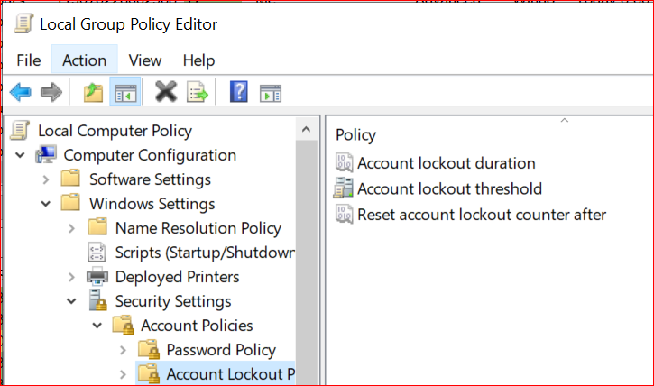
Corresponding policies
Computer Configuration -> Windows Settings -> Security Settings -> Account Policies -> Account Lockout Policy.
LockoutThreshold
ObservationWindow
LockoutDuration

Slide 6
ObservationWindow
If no re-occurrence in the past [ObservationWindow] period, then reset the badPwdCount to 0

Slide 7
Generic Logic
Lockout while (a bad password occurs) { counter++; if (counter = threshold) { account.lock(); LockoutDuration.trigger(); ObservationWindow.disable(); } else { ObservationWindow.reset(); ObservationWindow.trigger(); } }
Timers ObservationWindow.OnFire() { counter = 0; } LockoutDuration.OnFire() { account.unlock(); ObservationWindow.enable(); }

Slide 8
Password Validation
Definition: The mechanism which makes the associated account is temporarily disabled after a specified number of incorrect passwords are tried [within a specified period].
Question: how password is validated?

Slide 9
Password Validation
Protocol-specific
Kerberos:
AS, TGT
Occurs between client and DC
NTLM (and others):
Client delivers its credential to server in some format (protocol-specific)
Server validates the credential against the DC
Occurs between server and DC

Slide 10
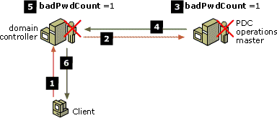
BadPwdCount
Incremented by 1 with each bad password validation attempt
When it reaches LockoutThreshold, the account is locked out
Validated against PDC before the final decision is made
Incremented on both PDC and authenticating DC upon the bad password validation attempt

Slide 11
BadPwdCount (cont.)
Reset to 0 after a successful validation
Also reset to 0 if no more bad password validation for the period of ObservationWindow since the last bad password validation
Maintained by each DC separately (not replicated among DCs)

Slide 12
Quiz
If there are K DCs, and LockoutThreshold = N, theoretically how many bad password validation may occur before the account is locked out?

Slide 13
When an account is locked out …
Replicated to PDC immediately [Immediate replication]
And then other DCs are notified [Urgent replication]

Slide 14
More Technical Details

Slide 15
Immediate Replication
The domain controller makes a remote procedure call (RPC) to the PDC operations master that includes the username and new password information. The PDC operations master then locally stores this value.
Occurs when:
Lockout of an account
Modification of a Local Security Authority (LSA) secret
State changes of the Relative ID (RID) Manager
https://docs.microsoft.com/en-us/previous-versions/windows/it-pro/windows-server-2003/cc775412(v=ws.10)

Slide 16
Urgent Replication
Change notification sent out without the notification delay.
Only makes sense for DCs within the same site if inter-site change notification isn’t enabled.
Occurs when:
account lockouts
changes in the account lockout policy
changes in the domain password policy
changes to the password on a domain controller account
https://blogs.technet.microsoft.com/kenstcyr/2008/07/05/understanding-urgent-replication/
https://blogs.msdn.microsoft.com/canberrapfe/2012/03/25/active-directory-replication-change-notification-you/

Slide 17
Account Lockout Policy
Should be defined in a GPO linked at domain level
If not defined in the Default Domain Policy GPO, then that GPO should take precedence over the Default Domain Policy GPO.
If linked at an OU level, it only affects the local accounts on computers in that OU.
https://docs.microsoft.com/en-us/windows/security/threat-protection/security-policy-settings/account-policies

Slide 18
Something else …
Password history check (N-2)

Slide 19
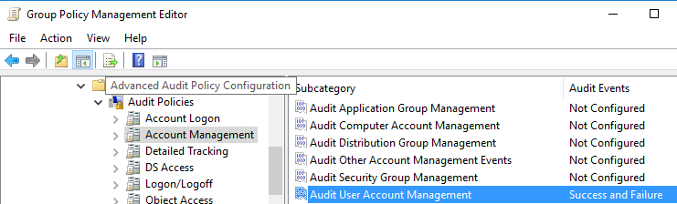
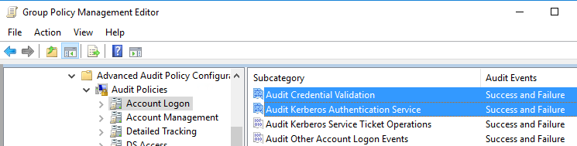
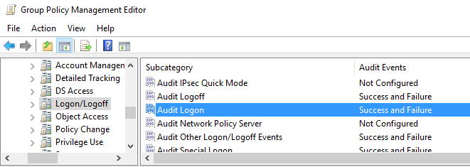
Audit
Audit User Account Management on all DCs
Account logon events in DCs
Audit Logon on the servers to access

Slide 20
Logon vs Account Logon
Logon
When a client app is going to communicate with a server service, it should first log on the host where the service is running
Account Logon
Credential validation of accounts for which the host is authoritative

Slide 21
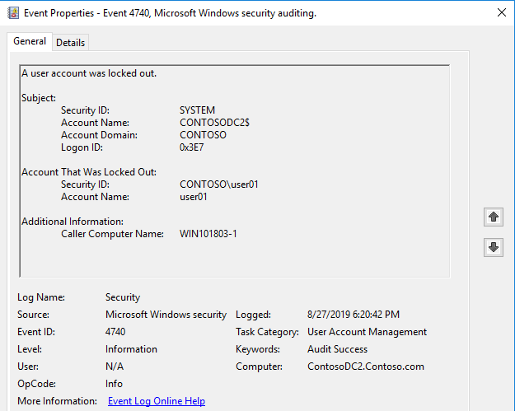
Events
Account lockout
4740 – account locked out

Slide 22
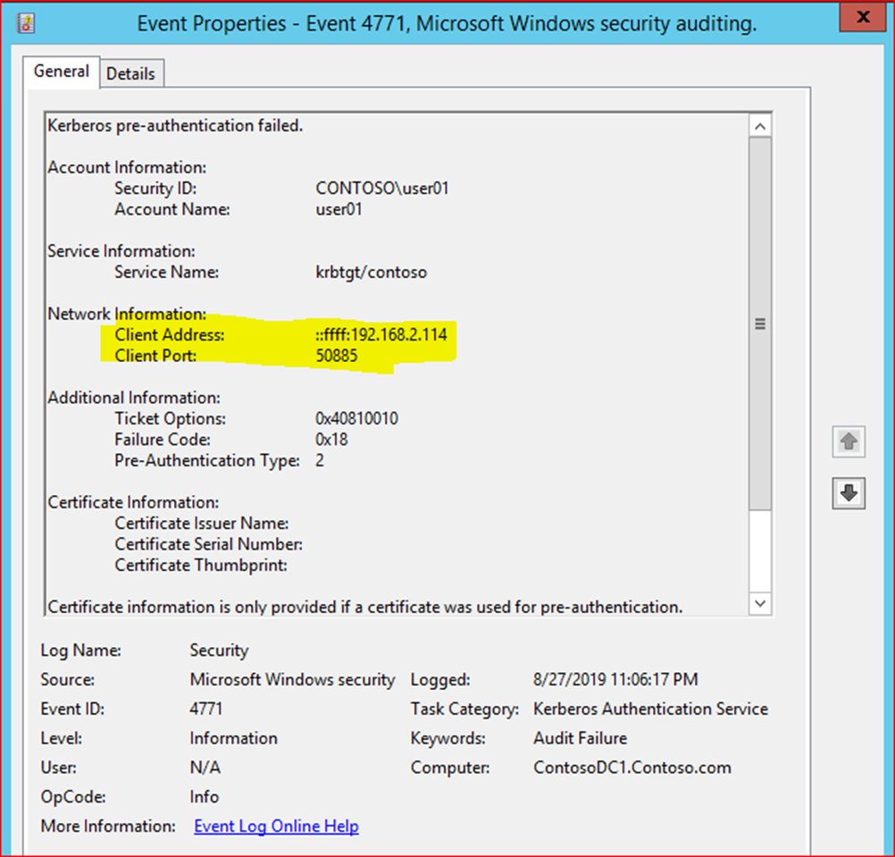
Events
Kerberos
4768 - pre-auth success
4771 - pre-auth failure

Slide 23
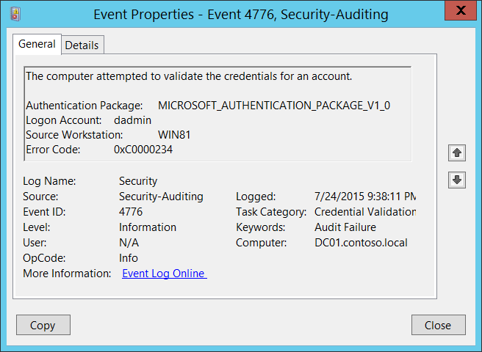
Events
NTLM
4776 - credential validation (Success and Failure)

Slide 24
Netlogon.log
Only useful in NTLM
Can get the server name as well as the client

Slide 25
Troubleshooting

Slide 26
Generic troubleshooting flow
Enable audit and netlogon debug log on all DCs, and wait for next occurrence
Enlarge the security event log maximum size
After re-occurrence, find out event 4740 containing the concerned username on all DCs
Filter out event 4771/4776 containing the concerned username on all DCs
Kerberos or NTLM?

Slide 27
NTLM
Identify the server from netlogon.log
Enable audit of logon events on that server
Start Process Monitor for network activity on that server
Wait for event 4625 containing the concerned username on that server

Slide 28
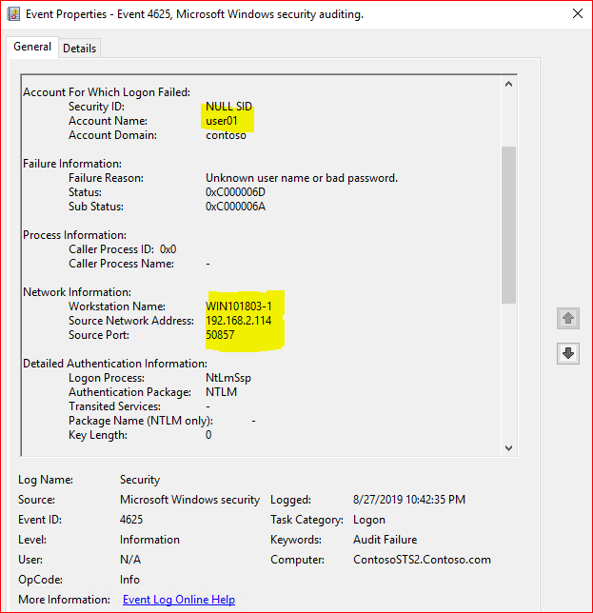
NTLM (cont.)
Get client hostname, IP address and source port from event 4625

Slide 29
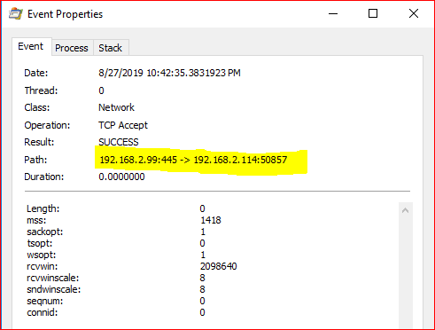
NTLM (cont.)
Use source IP and port to find out events in Process Monitor log
Get local port, and then identify the process

Slide 30

Kerberos
Identify the client IP from event 4771
Unfortunately, that’s all you can get ☹
Port belongs to SYSTEM
Try your best to identify the pattern from all 4771 instances from all DCs

Slide 31
Kerberos
Identify patterns
Does that account have specific usage?
Does all 4771 come from the same host or different hosts?
Does all 4771 occur at fixed moments or periods of the day?
Once the pattern is identified, try to capture netmon and procmon logs from the concerning host
Possible causes
Stale credential in credman
Stale credential stored in scheduled task
Stale credential stored by some service (MS or 3rd-party)
Attack (typically multiple accounts)

Slide 32
Sample Cases

Slide 33
Sample Cases
NTLM
Demo
Kerberos
Try to find out pattern from this log

Slide 34
Q & A

